Slide 1
Network Security
Principles of Network Security
Cyber Attack
Cyber Defence

Slide 2
Misunderstood Security Concepts
The 3 principles of Network Security.
Confidentiality, Integrity , Availability
What do these principles mean ?
→ These are the 3 main problem domains of Network Security that we need to solve
Cryptography
IS NOT Encryption!!!
It is the science or application of mathematical principles and algorithms to solve security problems.
Cryptography can be used to solve Confidentiality and Integrity problems BUT NOT Availability problems.
Authenticity is a problem related to both Confidentiality and Integrity
Techniques used in Cryptography:
Symmetric Key Encryption/Decryption
Asymmetric Key
Digital Signature
Digital Certificate
Cryptography Hash/Message Digest

Slide 3
Principles of Network Security
Network security is about protecting digital information resources and assets in the network
The primary goals are to ensure
Confidentiality (C)
Data on the network can be accessed only by authorized users
Integrity (I)
Data on the network can be modified only by authorized users
Availability(A)
Data as well as services are always accessible or available
Data can be static or in-transit
Confidentiality
Integrity
Availability
C.I.A. Triad
Notes:
Network Security is the process of by which the digital information resources and assets on the network are protected. We do not just protect the assets which have direct value to the company, we also need to protect the means to which these assets are used and accessed. That means not only must we protect the company’s trade secrets or its customer data, we must also protect the network devices and servers hosting the data and services.
To provide adequate protection of network resources, the procedures and technologies that we deploy need to guarantee three things, sometimes referred to as the CIA triad
ensure confidentiality,
maintain integrity and
assure availability.
The goals of network security is to enforce confidentiality, integrity and availability in the network.

Slide 4
Consequences of compromised in Network Security
Compromised in Confidentiality
Example | Consequence
Lose trade secrets, financial information to competitors | Revenue lost to competitor Financial loss
Compromised in Integrity
Example | Consequence
Company’s web site was vandalized by hackers replacing its original web contents | Lost of reputation Lost of Trust
Compromised in Availability
Example
Company network router was wrongly configured by administrator | Loss in productivity Loss of reputation Loss of revenue
Notes:
When one of the goals of network security is compromised , there will be detrimental consequences to the company.

Slide 5
Vulnerabilities, Threats and Attack
Vulnerability
Inherent weakness in the design, configuration, implementation or management of a network and its resources that makes it susceptible to threats
Threat
A threat is an activity (sequence of actions) with the potential for causing harm to the company’s assets and resources
Attack
Used a specific technique to exploit a vulnerability in the network.
Active attacks are the realization of threats and involves active work done by the attacker
At least one of the goals of network security (C, I, A) is compromised
Notes:
There are 3 categories of dangers that a company will face in enforcing network security.

Slide 6



Cyber Attacks
An intentional attempt to inflict damage (I), disrupt(A) or gain unauthorised access(C) to computer systems through the Internet
(1) Reconnaissance Phase :
Attacker gathers information about the target and scan for vulnerabilities
(2) Attack Phase:
Attacker carries out the actual attack and causes damage to the target.
(3) Cleanup Phase:
Attacker destroys evidence of the attack by clearing traces of the attack.

Slide 7
Vulnerable Code
SQLInjection.ipynb

Slide 8
Malware Malicious code, often referred to as malware, includes a wide range of software programs designed to harm, exploit, or otherwise compromise a computer system or network
Types | Definitions | Effects
Worms | A worm is standalone malware that replicates itself to spread across networks. | Can corrupt, delete, or steal data; often requires user action to spread.
Virus | A virus attaches itself to clean files and spreads through systems when the infected files are opened or executed. | Can corrupt, delete, or steal data; often requires user action to spread.
Trojans (Trojan Horses) | Disguises itself as a legitimate program or file to trick users into installing it. | Creates backdoors, steals data, or installs additional malware.

Slide 9
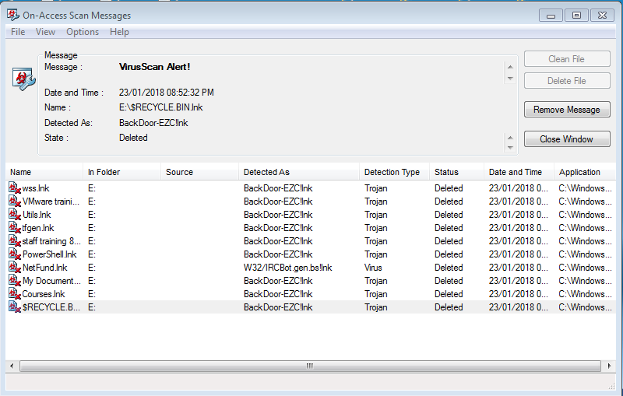
Preventing Cyber Attacks
Install Anti-virus/Spyware program
Install Personal Firewall
Update software regularly
Cookies management
Be vigilant when responding to emails or submitting personal information to web sites
Be diligent when importing module files from unknown sources into your code

Slide 10
Defending against Cyber Attack
Authentication
Authorisation
Cryptography

Slide 11
Authentication vs Authorisation
Authentication
Process of verifying the identity of user
User needs to prove who he/she claims to be by providing evidence
Something the user knows like login id and password
Something the user owns. Eg OTP (One Time Password) on mobile phone / token
Something unique that is measure from the user (Biometrics). Eg thumbprint, iris scan.
Multi-factor Authentication uses 2 or more evidence
Authorisation (Access Control)
Process of granting a level of access based on the identity of the user

Slide 12

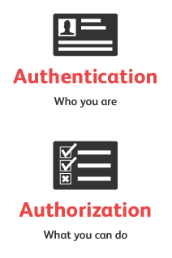



Compartmentalised Access
Prove who you claim you are
Administrator/Root
Administrative Rights
Access Control List
$$
$$
Identity
Multi-Factor Authentication
Digital Certificate
$$
$$
$$

Slide 13
Cryptography
The goals of cryptography are to secure communication by providing
Confidentiality
Integrity
Non-repudiation (cannot deny that an action has been performed)
Authentications
These goals can be achieved with a combination of digital techniques such as encryption/decryption, hashing and digital signature
Notes:
The goals of cryptography is very similar (BUT NOT THE SAME) to the goals of network security, it uses techniques to ensure secure communication across insecure medium.
Confidentiality : Data on the network can be accessed only by authorized users.
Integrity : Data on the network can be modified only by authorized users
Non-repudiation: Sender cannot claim he did not sign or send message when he actually did.
Authentication: The identities of sender and receiver are proven

Slide 14
Agenda for the next 5 weeks
Timed Practice
26 May 1pm to 4 pm
- 3 hour paper
- Topics (100 marks)
1 Q on Socket Programming
1 Q MongoDB/SQLite
1 Data Structure , Stack/Queue, LL, BST Hash Table (40 %)
1 General Problem Solving Sorting/Searching
3 July 8am to 9:30am - Theory (1.5 hour) Security, Networking, Database Modeling, Trace table/Tree, etc
Data structures II Algorithms

Slide 15
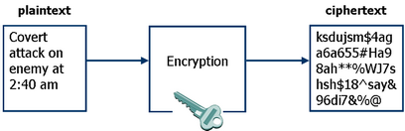
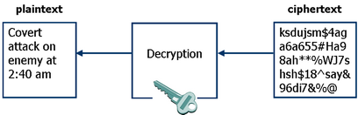
Encryption/Decryption
Uses an algorithm and a key
Primary Goal is Obfuscation
2 techniques
Symmetric and Asymmetric keys
Encryption – converting readable plaintext into non-comprehensible ciphertext
Decryption – converting non-comprehensible ciphertext into readable plaintext
Notes:
Examples of Encryption/Decryption algorithm
Using Symmetric key :
Data Encryption Standard (DES)
Advanced Encryption Standard (AES)
Triple DES
RC2,RC5
Using Symmetric key :
RSA
DSA
Diffie -Hellman

Slide 16
Symmetric-key Cryptography
Sender must communicate secret key to Receiver
Original Message
Encrypted
Message
Encrypted
message
In transit
Encrypted
message
Decrypted
Original Message
Secret Key is used for Encryption
Secret Key is used for Decryption
SENDER
RECEIVER
Problem:
Distribution of secret keys
Advantage:
Symmetric encryption/decryption is fast
Notes:
Before beginning to use symmetric cryptography, both sides need to have the key
One side can generate the key and send it to the other side
Both sides can then communicate securely
Problem: keys must be securely transferred to parties concerned
Keys can be lost / stolen
Keys can be changed during transit
Each pair of parties must have a unique key

Slide 17
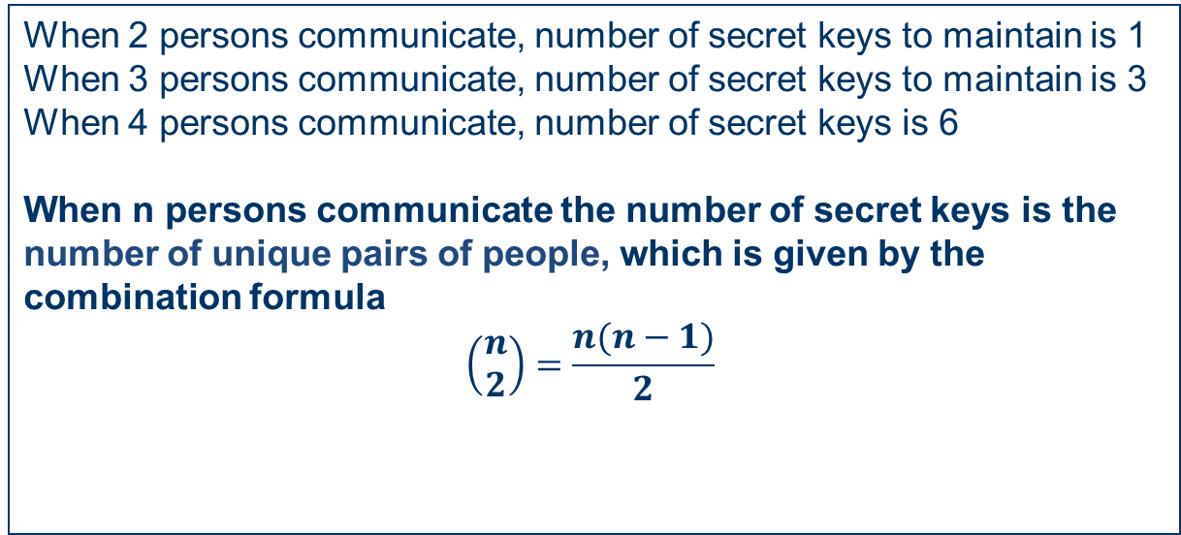



Symmetric cryptography – The Number of keys needed grows quadratically as the number of participants increase
A
B
❶
❷
❺
C
❸
❹
D
❻
Notes:
Too many keys if numberof parties communicating is large
No of keys = [p * (p-1)] / 2
Example:
2 parties communicating requires 1 key
4 parties communicating requires 6 unique keys, each party needs to hold 3 keys
20 parties communicating requires 190 unique keys, each party needs to hold 19 keys
300 parties communicating requires 44850 unique keys, each party needs to hold 299 keys

Slide 18
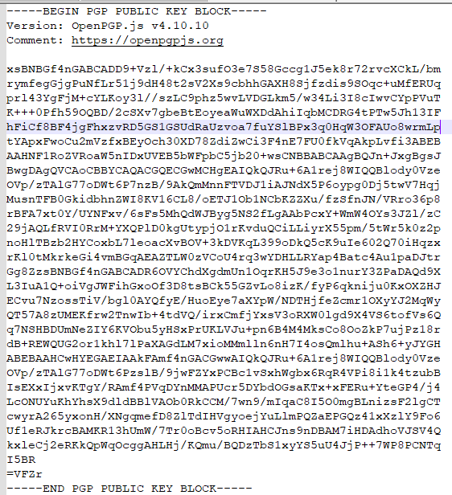


Asymmetric-key Cryptography
Receiver’s public key
Receiver’s private key
Original
Message
Encrypted
Message
Encrypted
message
In transit
Encrypted
message
Decrypted
Original
Message
SENDER
Sender encrypts message using receiver’s public key
Receiver decrypts message using his private key
RECEIVER
Uses a pair of keys, public + private key for encryption and decryption
Secure and manageable
Problem is slow encryption for large data
Notes:
Each party will have a unique pair of keys, public and private keys. The private key is kept by the owner and the public key is made available to everyone that wants to communicate with the party.
Private key has to be kept in secret from others and should be stored in a password-protected file/media or a secure tamper-proof hardware-device like a smart card.
Public key is available for everyone they can be
registered in public key stores/directory eg, http://pgp.mit.edu, http://keyserver.pgp.com, sks-keyservers.net
distributed by email
published in web sites/social media
One key to encrypt and the other key to decrypt. If the public keys is used for encryption, only its corresponding private key can be used to decrypt. Vice versa, if a private key is used for encryption, only its corresponding public key can be used to decrypt.
To communicate securely with another party, sender obtain the receiver’s public key and encrypt contents. Receiver decrypt’s using his private key
Keys required : Example
2 parties communicating requires 2 pairs of unique public/private keys, each party holds 1 private key and 1 public key
4 parties communicating requires 4 pairs of unique public/private keys, each party holds 1 private key, and 3 public keys
20 parties communicating requires 20 pairs of unique public/private keys, each party holds 1 private key, and 19 public keys
300 parties communicating requires 300 pairs of unique public/private keys, each party holds 1 private key, and 299 public keys

Slide 19
Email scenario using Asymmetric Cryptography
Alice wishes to send a secret message to Bob
She looks up Bob's ___public___ key in a public directory
Alice uses it to encrypt the message and sends it off
Bob then uses his ___private____ key to decrypt the message and read it
No one listening in can decrypt the message
Anyone can send an encrypted message to Bob, but only Bob can read it (because only Bob knows Bob's private key)

Slide 20
Asymmetric Crypto using RSA
The RSA (Rivest–Shamir–Adleman) Algorithm uses Asymmetrical Cryptography
Demo / Practice
Using PGP Online tool, generate a pair of keys download them as publicKey.txt and privateKey.txt
Publish your public key in the Message Board padlet by uploading the file, keep your private key secret
Use your friend's (Recipient) public key to encrypt a secret message for him/her.
Copy the public key from the padlet post)
Copy the generated encrypted text and save it in a file, encrypted.txt
Create a post in padlet (make sure you address the person) and upload the encrypted.txt file. . (You cannot paste the encrypted text directly in the post)
Decrypt any secret messages received using your private key.
Tools PGP Online : https://onlinepgp.com/
Message Board: https://for.edu.sg/cz2a-padlet
( DO NOT USE)
Public Key Store: https://keys.openpgp.org/

Slide 21
Cryptography Hash Functions
One-way Function
Non reversible
Maps input data of any size to a fixed sized output known as a digest or hash
A tiny change in the input message produces a drastic change in the hash output
The output is designed to make collisions computationally infeasible
Examples of Cryptography Hash Algorithm: MD5 (Broken), SHA1(broken), SHA256 (most commonly used)
Message
Hash output
Hash Algorithm
“Hello World”
ED30C8B0ADE5D8E8
645699E39AFC45AC
Message
Hash output
“hello World”
Hash Algorithm
5061E7DA9FB9FA9B
97C5167F3AF66B49
Message
COLLISIONSHIGHLY
UNLIKELY
“Bye Bye”
Hash Algorithm

Slide 22
Digital Signature
A digital signature serves the same purpose as a handwritten signature
Digital signatures provide:
Authentication. The person digitally signing the message is really who he claims to be.
Non-repudiation. Signer cannot deny that he did not sign the document
Integrity. The data was sent and received without any alteration or modification

Slide 23

Signing a digital message with a Digital Signature
SENDER
The original message is appended with the Digital Signature and send
RECEIVER
Original Message
Sender generates a hash of the original message
Original Message
Hash of
Original Message
(Message Digest)
Sender signs the hash using the sender’s private key
Digital
Signature
To Receiver
SENDER
Digital
Signature

Slide 24

Verifying a Digital Signature
From Sender
RECEIVER
Original Message
Receiver generates a hash of the original message
Digital
Signature
Receiver re-construct the hash from the signature using the Sender’s public key
SENDER
Verify the re-constructed hash with the hash of the message
Re-constructed Hash
(Message Digest)
Hash of
Original Message
(Message Digest)

Slide 25
Verifying a Digital Signature
The Sender refers to the owner of the public key used during the verification process
IF the verification returns True
Authenticated Sender. The sender is authenticated
Non-repudiation. Sender cannot deny that he did not sign the message.
Integrity. The data was sent and received without any alteration or modification since a hash of a altered message will give a different output
IF the verification returns False
Failed Authentication. The sender did not send the message
Repudiation . Sender can deny sending the message
Failed Integrity. Message was modified

Slide 26
How can you trust the public key of Alice belongs to Alice ?
Alice
Hey Bob, What's up
Alice
Digital
Signature
Or the web site https://www.google.com.sg you are browsing is really google ?

Slide 27
Public Key Infrastructure (PKI)
Public keys are used to uniquely identify a user or computer.
We can use them to send encrypted contents to a recipient or to verify the identity of a sender.
A public key infrastructure supports the distribution and identification of public encryption keys, enabling users and computers to securely exchange data over an untrusted network such as the Internet.
A PKI consists of the following elements
Certificate
Certificate Authority (CA)
Certificate Store

Slide 28
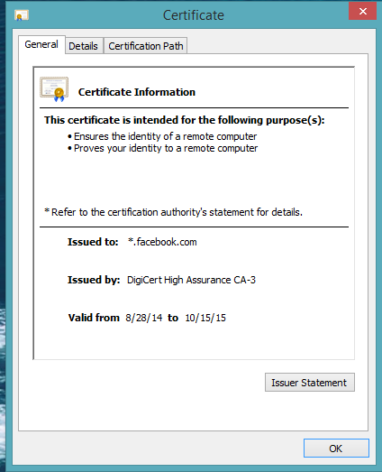
Digital Certificate
A digital certificate contains the following information
Subject’s (user or computer) identity
Issuer’s identity (CA)
Valid Period
Public key of the subject
A digital certificate maps a subject (person or computer) to a public key
Guaranteed by the Issuer

Slide 29
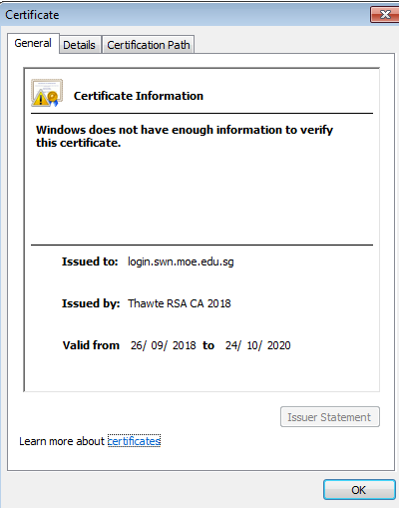
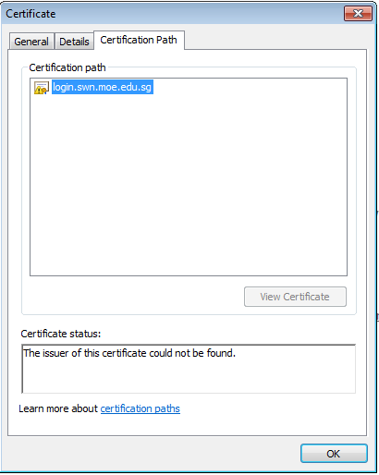
Invalid Certificate

Slide 30
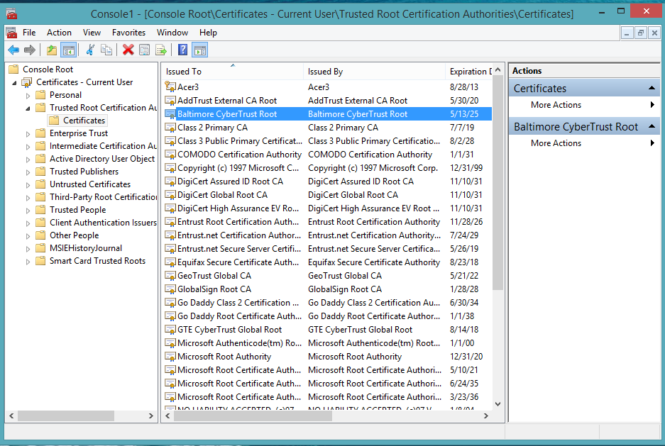
Certificate Authority (CA)
Windows Certificate Store
A trusted third party that verifies and certifies the authenticity of the subject and the public key
Issues Certificate
Commercial/Public CAs
DigiCert, GlobalSign, Symantec, Comodo
Private CAs
Used in an intranet environment
Computers store a list of Trusted CA on the computer’s Certificate Store. (Windows already has a list of CAs pre-installed on its certificate store)
A Certificate Store is a secured storage on a computing device or media.
Certificates must be issued by one of the list of Trusted CA in order to be trusted. (ie the public key in the certificate maps to the subject)
Certificate Search
https://crt.sh/
Notes:
In order to use a public key to perform encryption or to verify a signature in a PKI, we must first obtain a certificate of the subject. Example, if we want to encrypt contents to send to a web site, the URL of the web site must match the subject in the certificate
Next we must verify that the certificate is issued by a trusted CA. The CA ‘s certificate must have been install in the certificate store.

Slide 31









SSL/TLS - Secure Socket Layer
SSL/TLS is the de facto standard in protecting transmission on the Internet.
TLS is the new name for SSL. For simplicity, we shall refer to it as SSL
Client uses a public key from the server’s certificate to initiate a encrypted session that exchange a shared secret key
The server’s certificate must be issued by a trusted CAs recognized by the client computer
This shared secret key is for subsequent encrypted sessions using symmetric encryption/decryption
Secured using Asymmetric keys
Secured using symmetric keys
Notes:
Why must a shared secret be used instead of using public/private key ?
Steps for Client to initiate a SSL session with a server
Client requests to use SSL ( indicate by using https in the URL)
Server returns a Certificate to the client
Client checks
The certificate is issued by a Trusted Certificate Authority. Client must have the Certificate Authority’s self-signed certificate installed in its certificate store.
The subject of the certificate matches the server it is accessing
The certificate has not expired
Client uses the server certificate to initiate an encrypted session that exchange a shared secret key
The secret key is used to provide symmetric cryptography in subsequent sessions with the server.

Slide 32






Unauthorised Access on the Network
Firewall
- prevents unauthorised access
Physical network device that is located between a public and a private network
Software that runs on a computer.
-Monitors the traffic on the network
identifies the source and type of application trying to gain access to
Based on the rules configure, either block or allow access

Slide 33
Firewall
Packet filters
Looks at each packet entering or leaving the network and accepts or rejects it based on user-defined rules
Packet filtering is fairly effective and transparent to users

Slide 34
Packet Filtering
Location of the Packet Filter
The packet filter can be placed at one of two places or both:
at the network-level (router-based)
at the host-level (host-based)
Notes:
Router + Screener = “Screening Router”

Slide 35


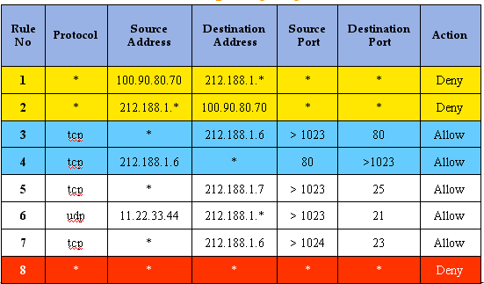
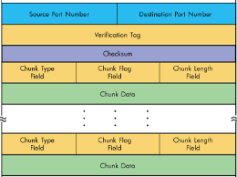
6.3 Packet Filtering
How packet filters are work (default-deny)
1
2
Packet meets firewall
Firewall checks the packet against rules and decides if packet should be allowed thru
See next slide on how the decision is made

Slide 36
6.3 Packet Filtering
How the packet filter decides if packet is to be allowed through
Firewall checks the 1st/next rule – ALL criteria match? Apply Action
2a
No complete match? Go to next rule
2b
2c
Is this the last rule?
YES - Apply default action
NO – go to next rule

Slide 37
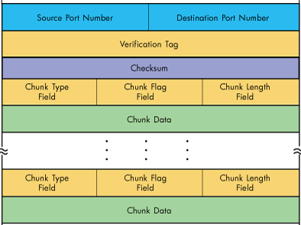
6.3 Packet Filtering
How the packet filter decides if packet is to be allowed through
All fields in match those in rule 2?
YES – Deny packet, wait for next packet
NO – go to rule 3

Slide 38
6.3 Packet Filtering
How the packet filter decides if packet is to be allowed through
All fields in match those in rule 3?
YES – Allow packet, wait for next packet
NO – go to rule 4

Slide 39
6.3 Packet Filtering
How the packet filter decides if packet is to be allowed through
Since no rules match, apply the default rule

Slide 40
Firewall cannot detect and prevent
(Distributed)Denial of Service Attacks
- Overwhelm a server by flooding it with fake requests

Slide 41

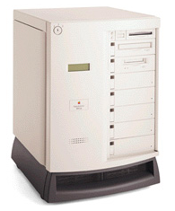
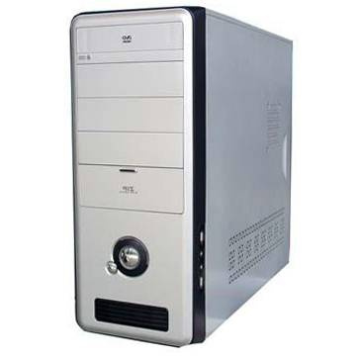
Distributed Denial of Service Attack
ATTACK
https://njc.co
Attackers
SYN Flood Attack
Vulnerability
TCP 3-way Handshake
Firewall
njc
network
18.139.47.66
Web Server
njc.co
Database Server

Slide 42
Intrusion Detection System (IDS) vs Intrusion Prevention Systems (IPS)
Scan for patterns in the incoming packets
IDS is passive
Only detects and send notifications
To prevent False Positives
Logs intrusions detected
IPS is pro-active
Detects and Blocks
Logs intrusions detected

Slide 43
The Domain Name Service (DNS)
To locate a resource on the Internet , we use a URL
https://njc.co/login which consists of the domain name and the resource
The domain name has to be resolved into an IP Address in order for the data packets to reach its destination. i.e njc.co must be resolved into 18.139.47.66
This DNS resolution is provided by DNS Servers on the Internet (by ISP)

Slide 44
Domain Name Space
DNS Record: maps a name to one or more IP address
Authoritative DNS Server of a domain
Root-Level Domain
Top-Level Domain
Countries
New Zealand (NZ)
CO
SG
ORG
Second-Level Domain
www
Client
njc
Google
MyRepublic
Notes:
A DNS server contains IP addresses of sub-domain DNS servers as well as a host IP address. It resolves the IP addresses of domain names.

Slide 45
Example : CloudFlare IDS/IPS
ATTACK
https://njc.co
Attackers
Reverse Proxy
DNS will not resolve njc.co to 18.139.47.66
DNS will distribute all requests to njc.co to a range of IP addresses of CloudFlare's IDS/IPS servers
Malicious traffic will be absorbed by the IDS/IPS
IDS/IPS will forward only clean traffic to 18.139.47.66
IDS/IPS
IDS/IPS
Firewall
Reverse Proxy
njc
network
18.139.47.66
Web Server
njc.co
Database Server

